Slide 1
Moai by Peopoly
Hardware Installation Guide

Slide 2
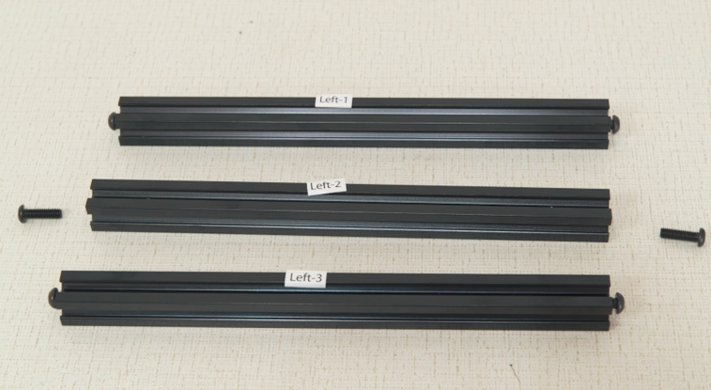
Please find these 3 horizontal bars.
They are labeled:
“Left1”
“Left2”
“Left3”

Slide 3
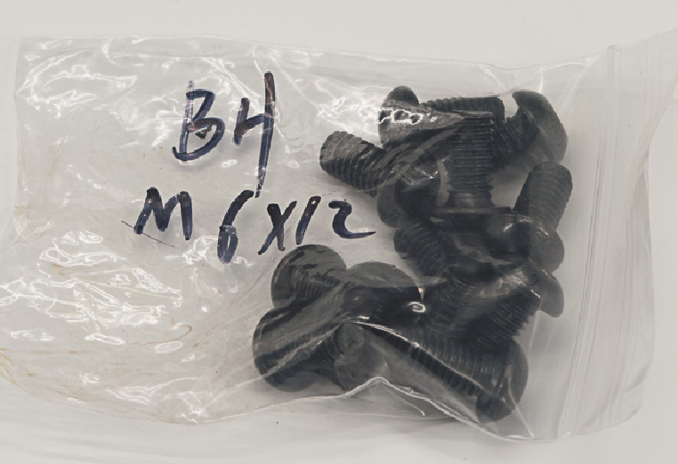
Please take 4 screws from the bag labeled “BH M6x12”
Screw two per bar half way on the ends of “Left1” and “Left3”
Screw them in until there is 3 to 5mm remaining out
This will make it easier to align with the slots in the frame in later steps.

Slide 4
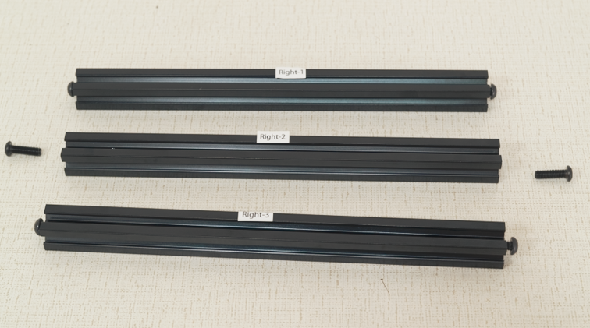
Please find these 3 horizontal bars.
They are labeled:
“Right1”
“Right2”
“Right3”

Slide 5
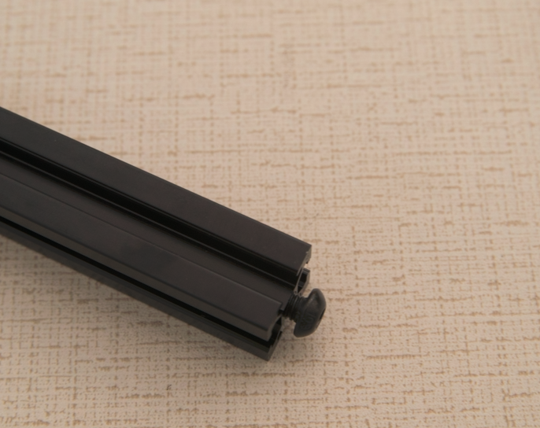
Please take 4 screws from the bag labeled “BH M6x12”
Screw two per bar half way on the ends of “Right1” and “Right3”
Screw them in until there is 3 to 5mm remaining out
This will make it easier to align with the slots in the frame in later steps.

Slide 6
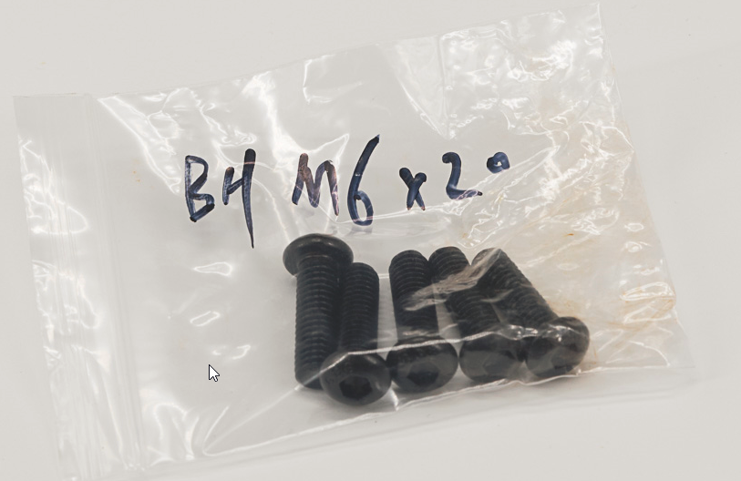
Please take 4 screws from the bag labeled “BH M6x20”
Screw these halfway in the ends of Left2 and Right2 bars. 2 Each bar.
Screw them in until there is 3 to 5mm remaining out
This will make it easier to align with the slots in the frame in later steps.

Slide 7
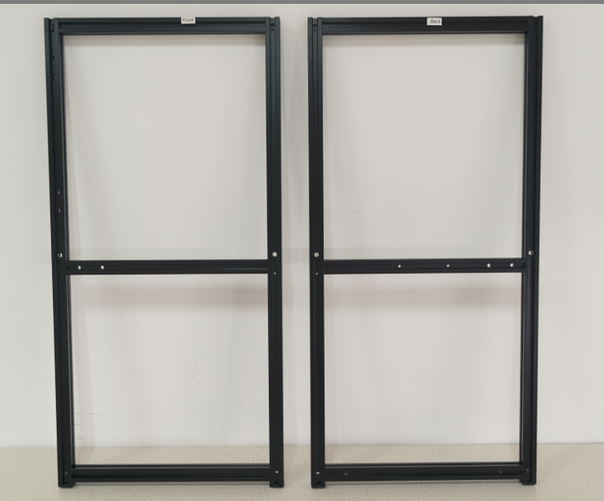
Please find assembled front and back frames labled Front and Back
The front frame has labels start with Front
The back frame has labels start with Back
The side of each frame that is facing outward is where the sticker is located.

Slide 8
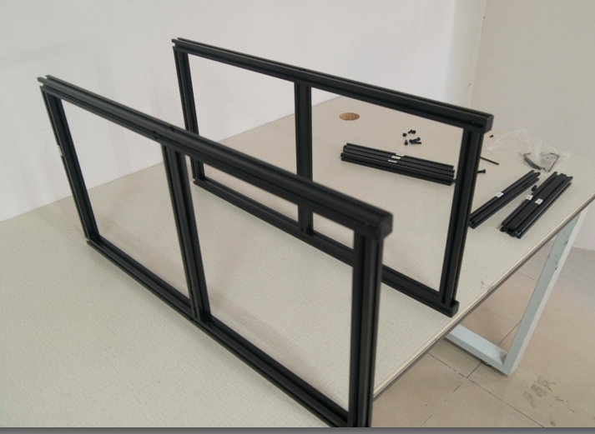
Put Front and Back Frame in parallel on the table
Put Front on the left hand side, with sticker facing left. Rubber feet facing you.
Put Back Frame on the right, Sticker facing right. Rubber feet Facing you.
Where the sticker is facing is important. The stickers for the front and the back should be facing away from each other.

Slide 9
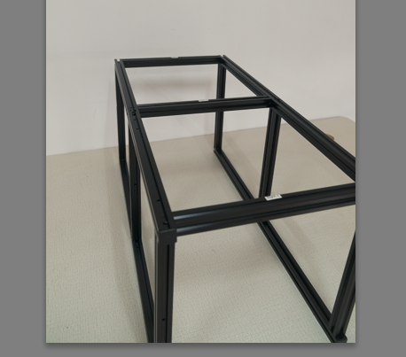
Install Right1, Right2, Right3 bar between Front and Back frame
First Install Right3, put the screw in the slots of the extrusions and slide all the way down to the rubber feet.
Then Install Right2, Use the previous found BH M6-20 THROUGH the clearance hole midway on the extrusion.
Finally Install Right1 at the top of the frames.
Sticker side of each bar should face outward
Do not overtighten - you may need to adjust things slightly in later steps.

Slide 10
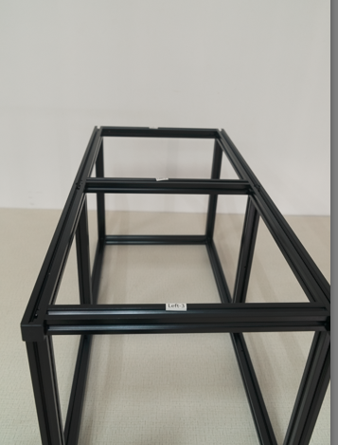
Install Left1, Left2, Left3 bar between Front and Back frame
Flip the frames over
First Install Left3, Slide the screw in the slot of the extrusions all the way down to the rubber feet.
Then Install Left2, Use the previous found BH M6-20 to secure it THROUGH the clearance hole midway on the extrusion.
Finally Install Left1
Sticker side of each bar should face outward
Do not overtighten - you may need to adjust things slightly in later steps.

Slide 11
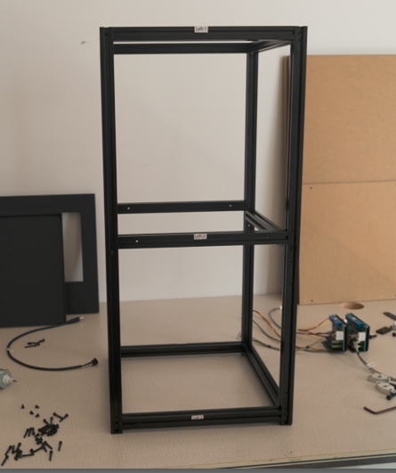
The frame should look like this when it is done correctly
The stickers from all 4 sides should face outward, as in the picture.
If you have problem, you can use this video as guideline

Slide 12
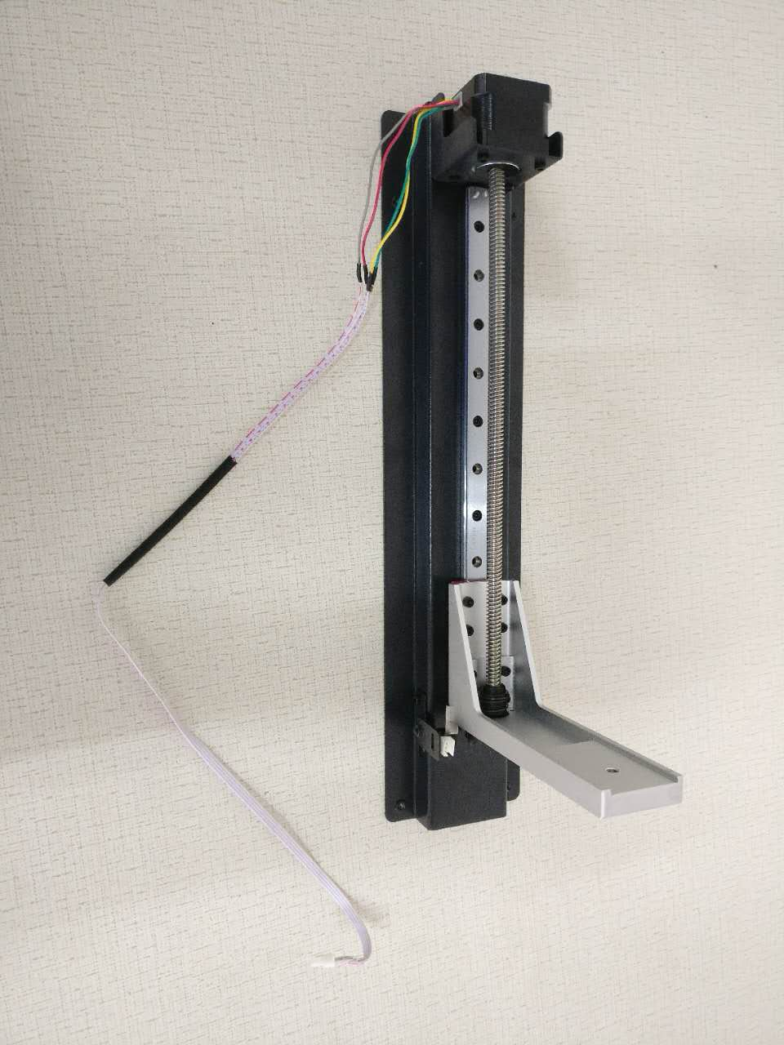
Find the assembled Z-Axis Assembly in the box that looks like this.

Slide 13
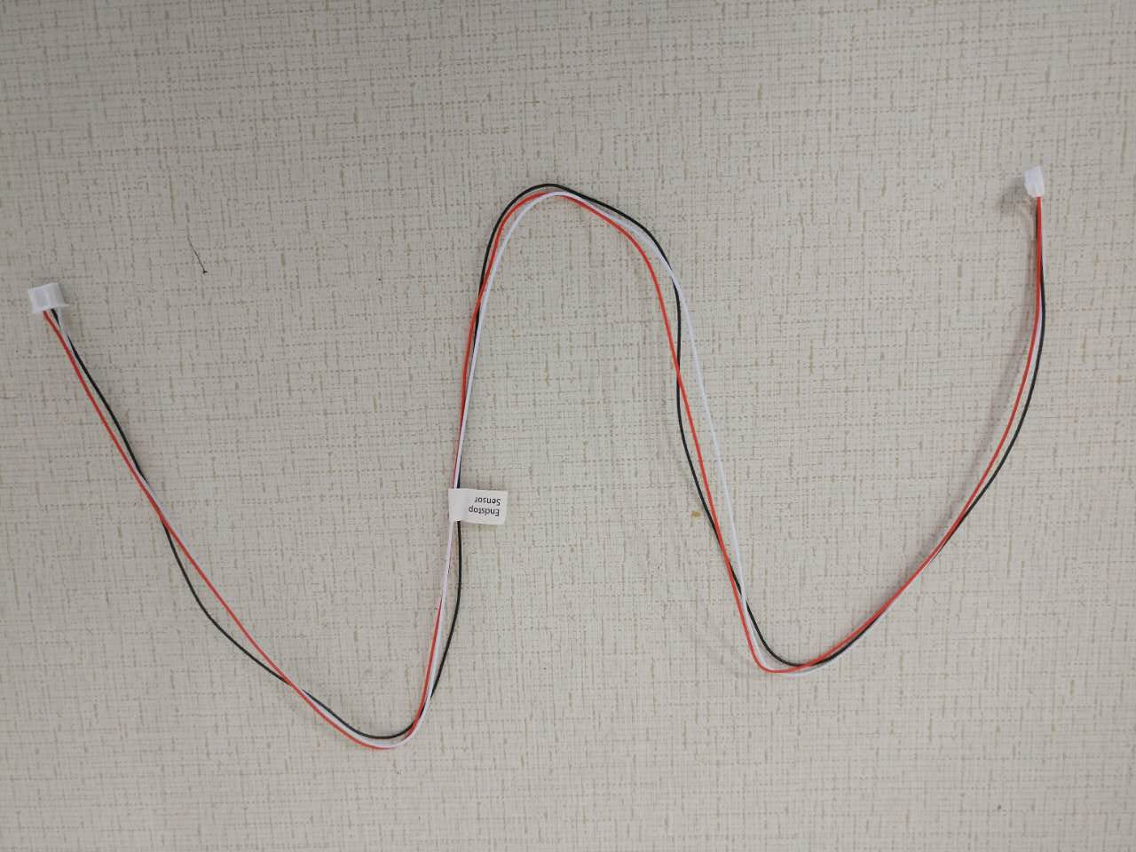
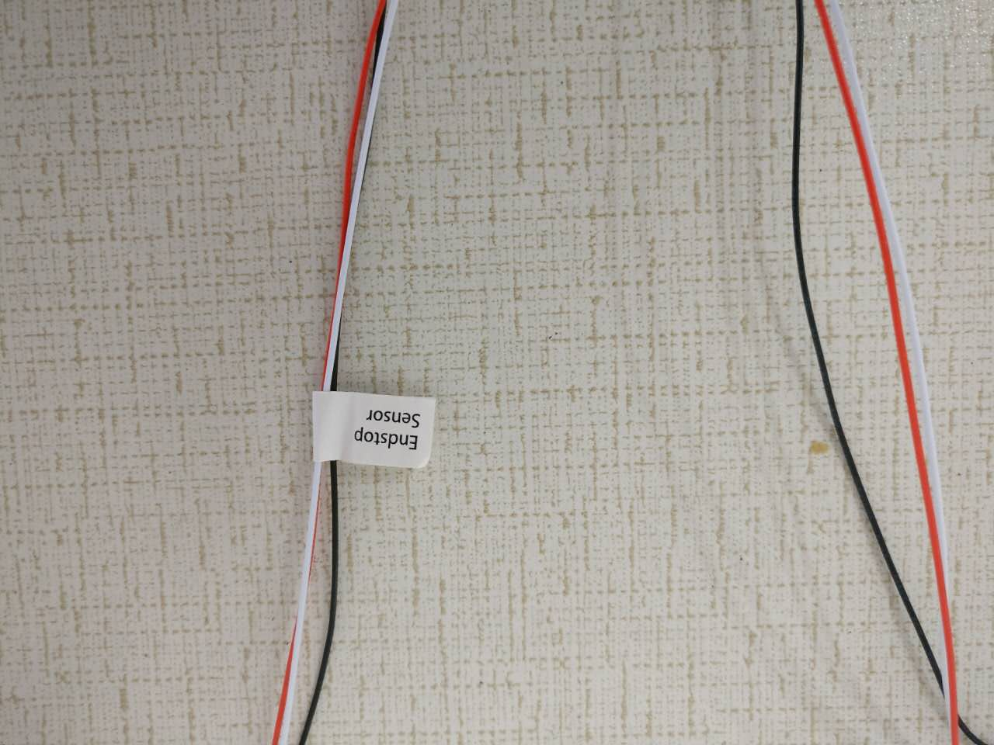
Find the Endstop Sensor cable that looks like this:

Slide 14
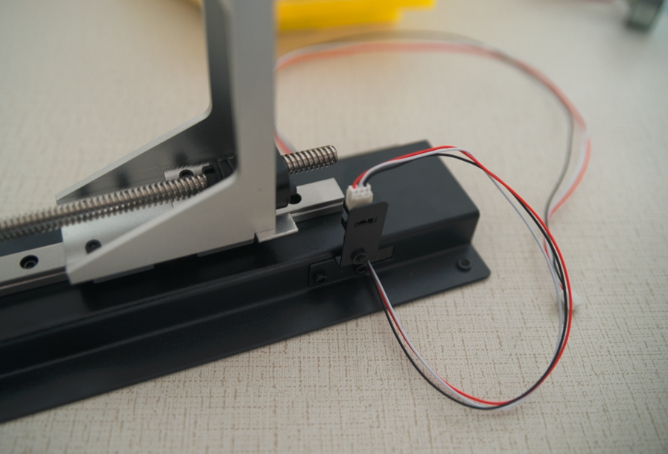
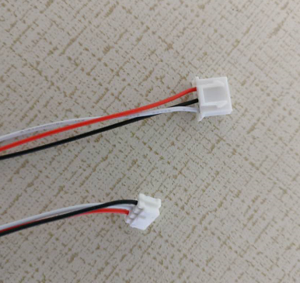
Connect Endstop Sensor cable to Z-axis as following
The smaller connector on the endstop sensor cable goes into the socket on the Z-axis sensor. Match the alignment ridges to the gaps in the connector.
Ensure connection is secure as this is needed to stop Z-axis motor from over extending the build plate arm

Slide 15
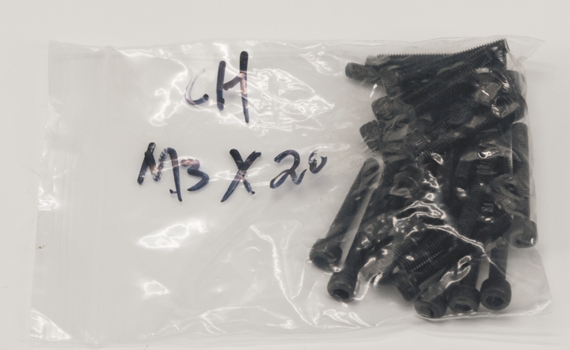
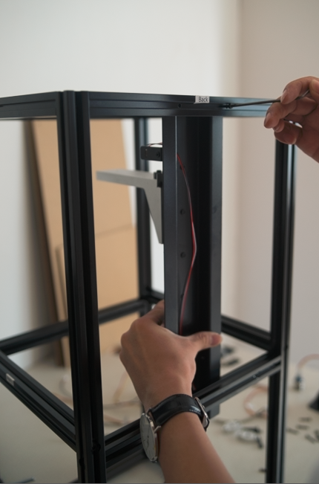
Find 4 CH M3-20 screws and use it to Mount Z-Axis to Back frame.
Route the Z end stop sensor cable between the z stop assembly and the horizontal bar.
The bolt head goes on the outside of the frame and screws into the built-in threads
on the Z-axis.

Slide 16
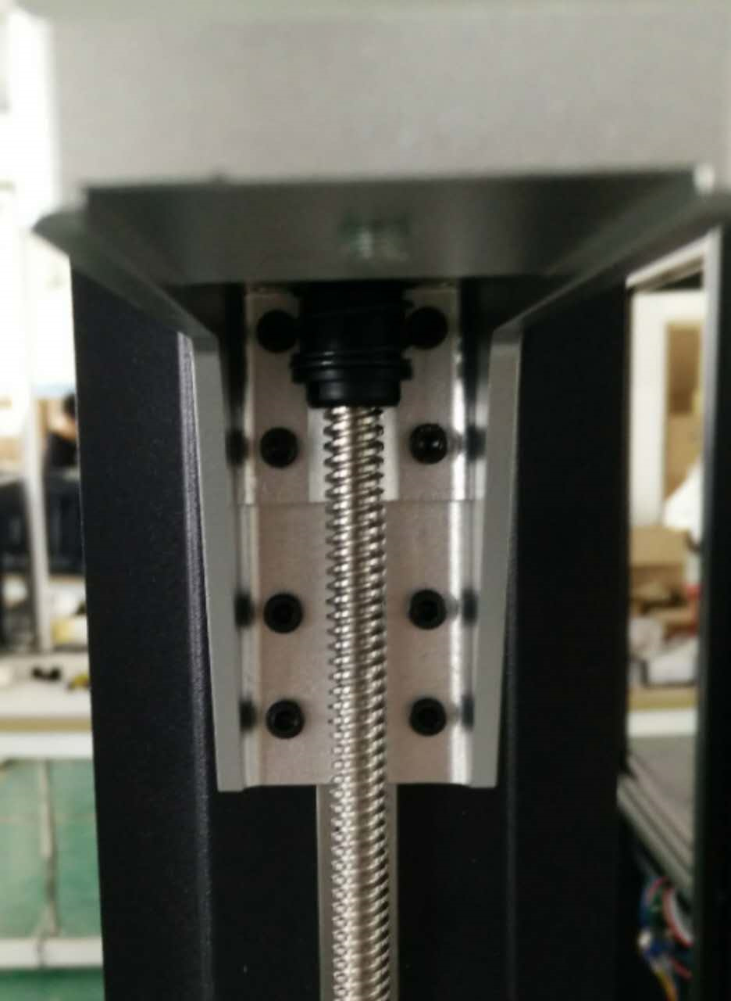
When installing, we now recommend checking to see these eight screws locking the build plate arm are secured. The screws may have become loose during shipment.

Slide 17
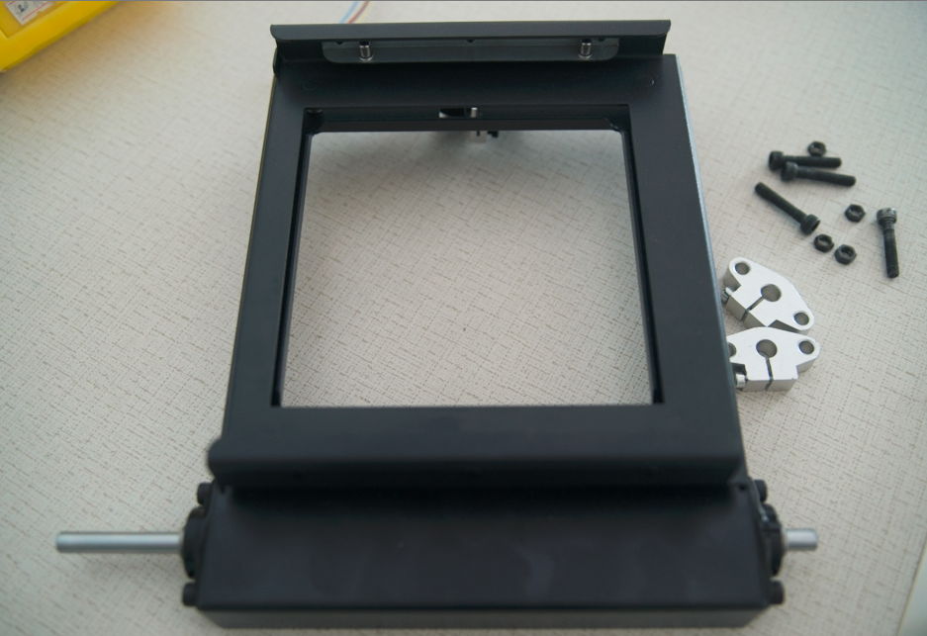
Once the Z-Axis is secured, find the Platform, it comes assembled.

Slide 18
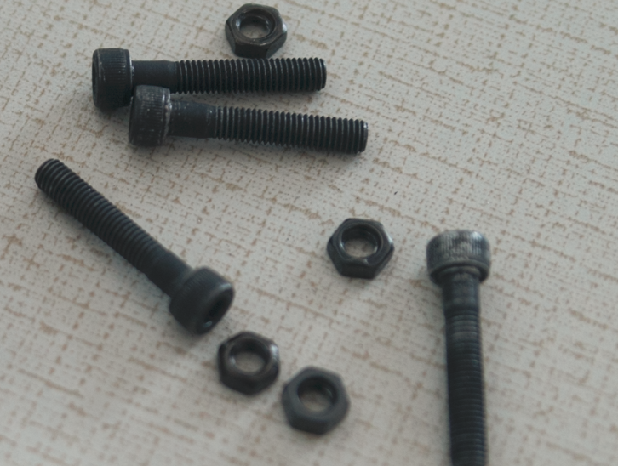
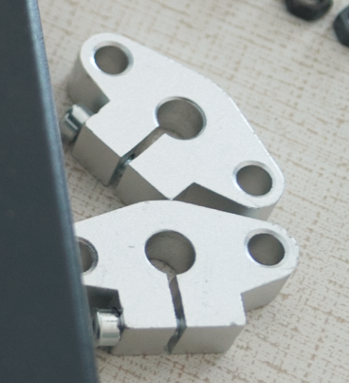
Find 4 CH M5-27 screws and nuts and the 2 silver brackets.

Slide 19
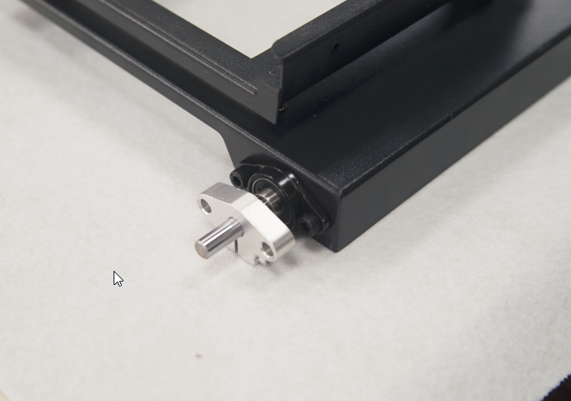
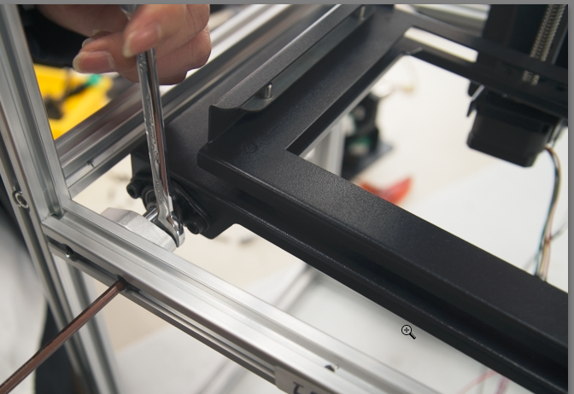
Put the Silver Brackets on each end of the Platform’s metal rod with the slot facing DOWN.
Install the Platform cross from Front and Back frame with the rod near the Left Frame Use CH M5-27 screws to secure. Loosely install both Silver Brackets before tightening, as you may need to make adjustments later.

Slide 20
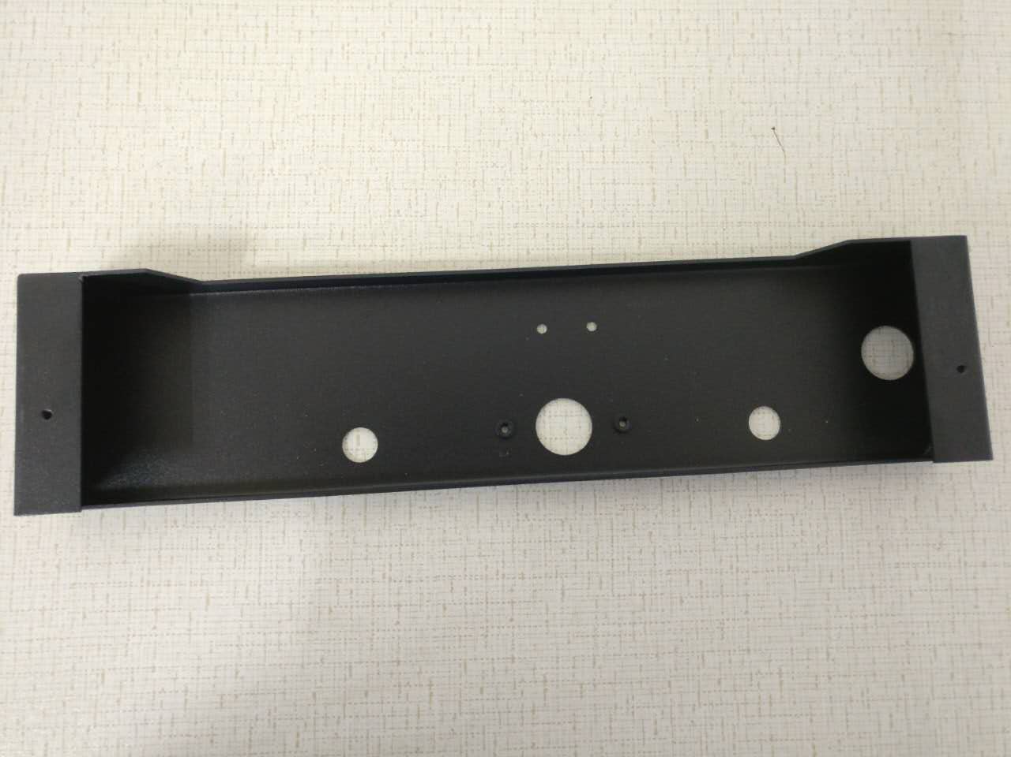
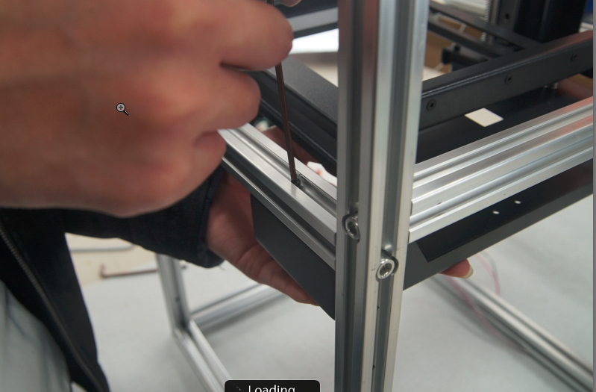
Find the below Rise motor bracket and secure it between the Front and Back frames near Right side with 4 CH M3-20 screws.
Install the top 2 screws first, then the back 2 should go in easily.
Right Frame
Front Frame
Right Frame

Slide 21
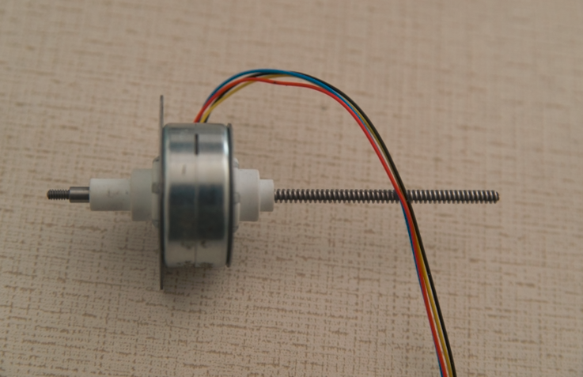
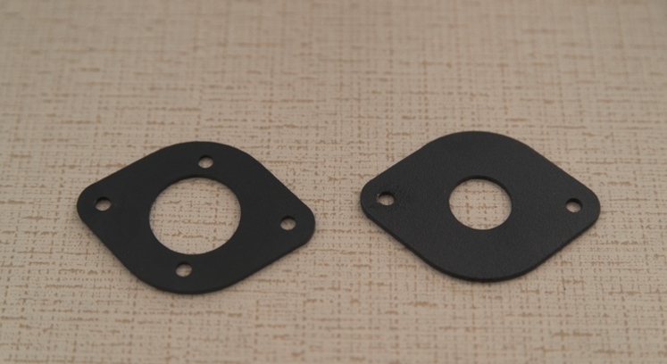
Find the Rise Motor and the two Brackets.

Slide 22
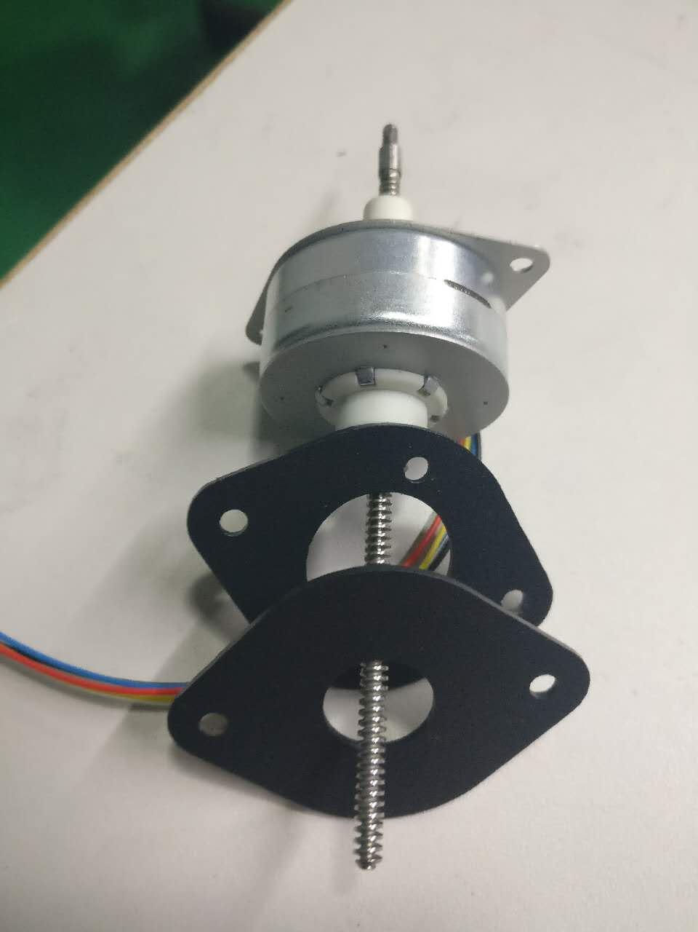
Install Brackets on Rise Motor like this:
The bracket with larger center hole goes on first.

Slide 23
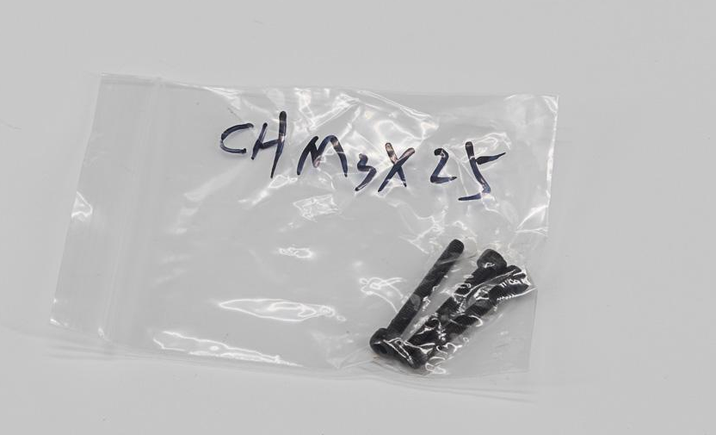
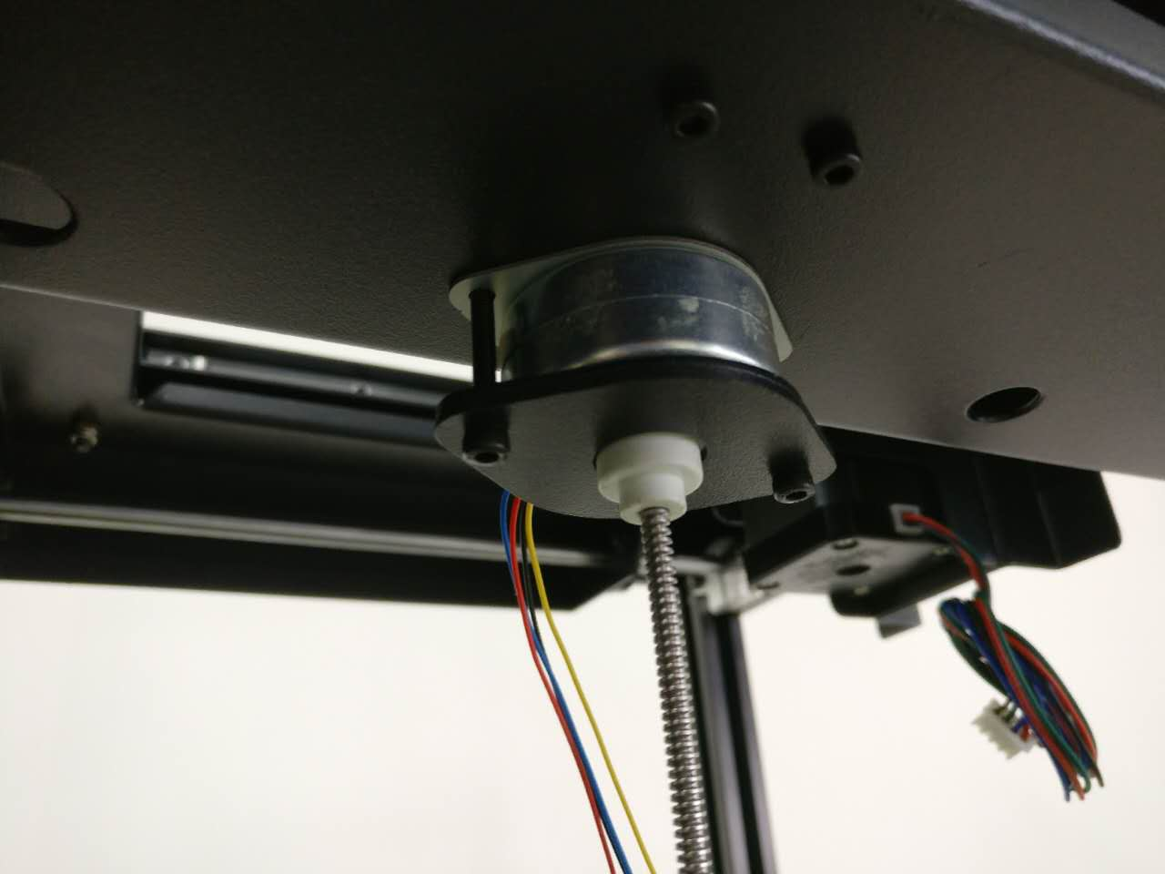
Secure the Rise Motor with 2 CH M3-25 from the bottom near Right frame. Do not tighten until both screws are installed. Do not over tighten.

Slide 24
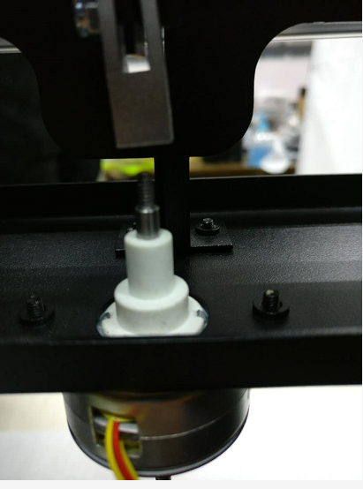
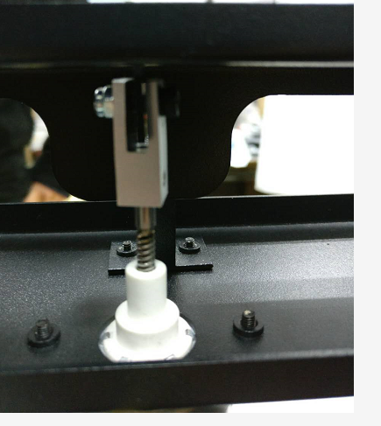
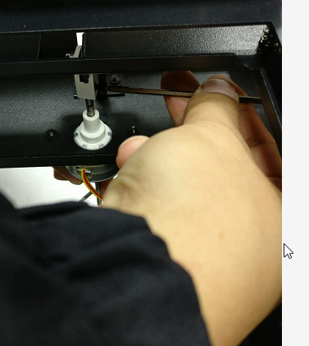
Use your hand to turn the long threaded end of the Riser Motor axle downward to fully retract the short end. Then turn the axle so that it screws fully into the Silver Yoke. TIghten the CH M3-4 or CH M3-5 Yoke Set screw to secure.
Make sure the Yokeis straight with the Riser Motor’s beam.

Slide 25
After installing and aligning the Riser Motor to the platform, secure the metal rod so it does not wiggle. Secure and tighten all screws pointed out by arrows in the pictures below. There are 3 on each Silver Bracket
Follow video here if you have issues.
*It is common for users to forget this step and it affects printing later on.

Slide 26
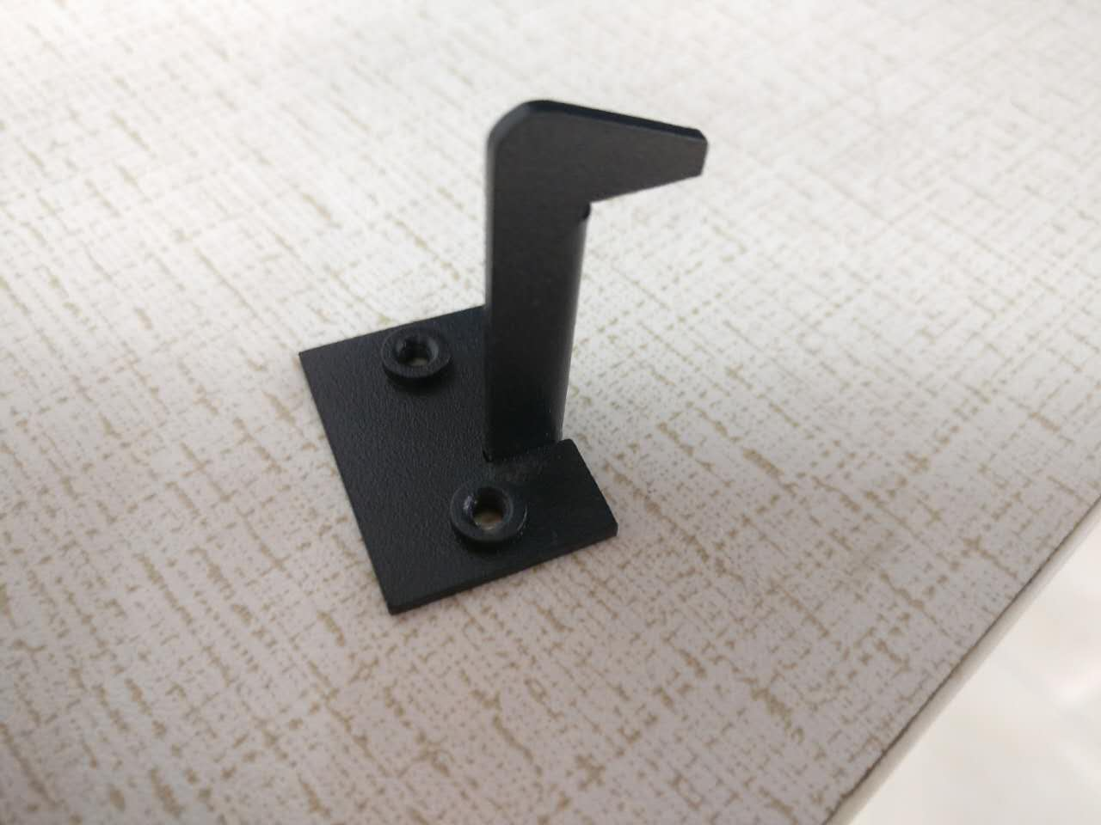
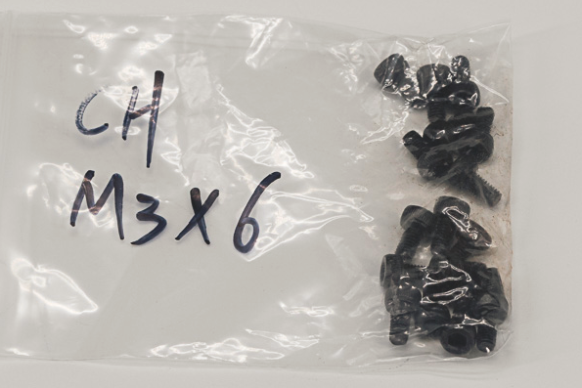
Find the Riser plate hook and 2 CH M3-6 screws

Slide 27
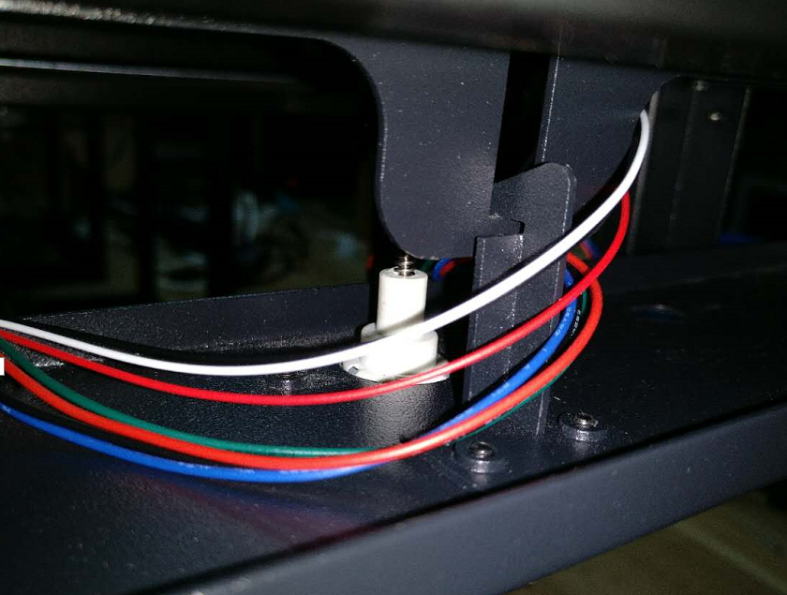
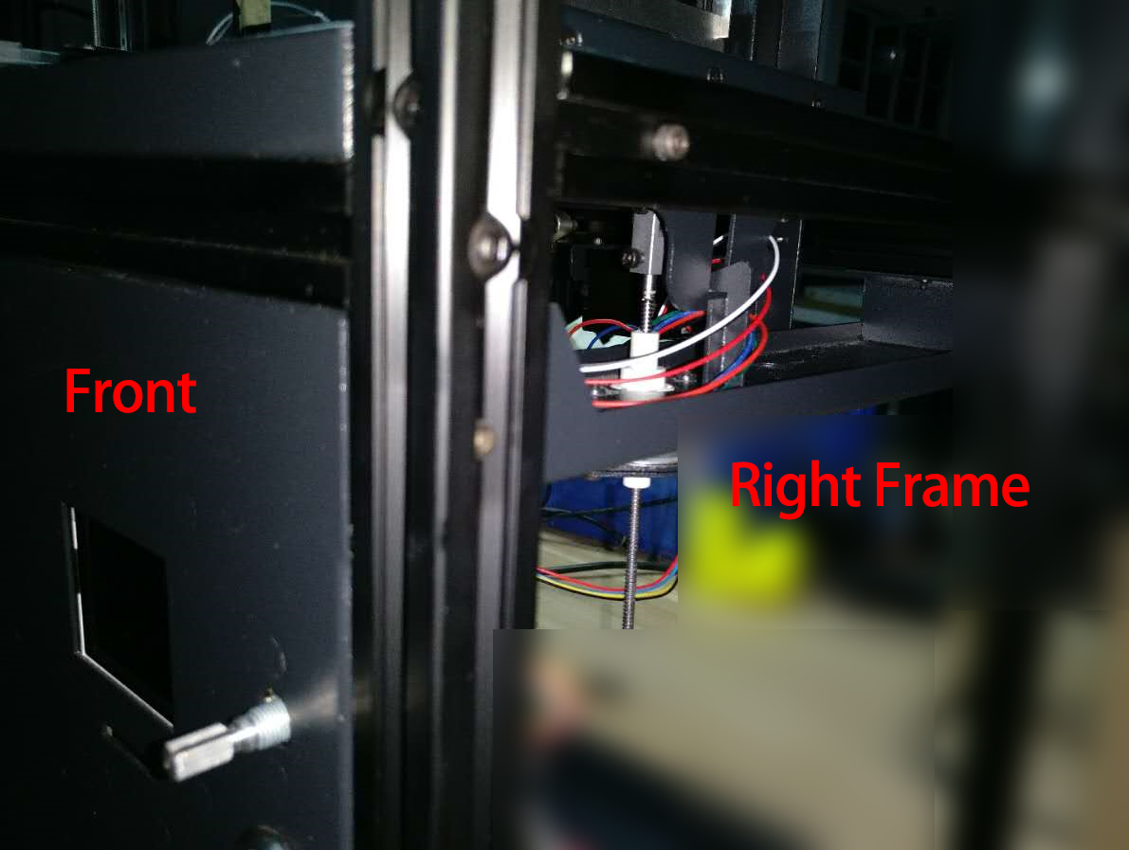
Secure the riser plate hook at the 2 screw holes near the riser motor with CH M3-6 screws with the Hook facing inside of the machine, pointing toward to the Rise Motor.
Installation tip video here
Metal Hook
Riser Motor

Slide 28
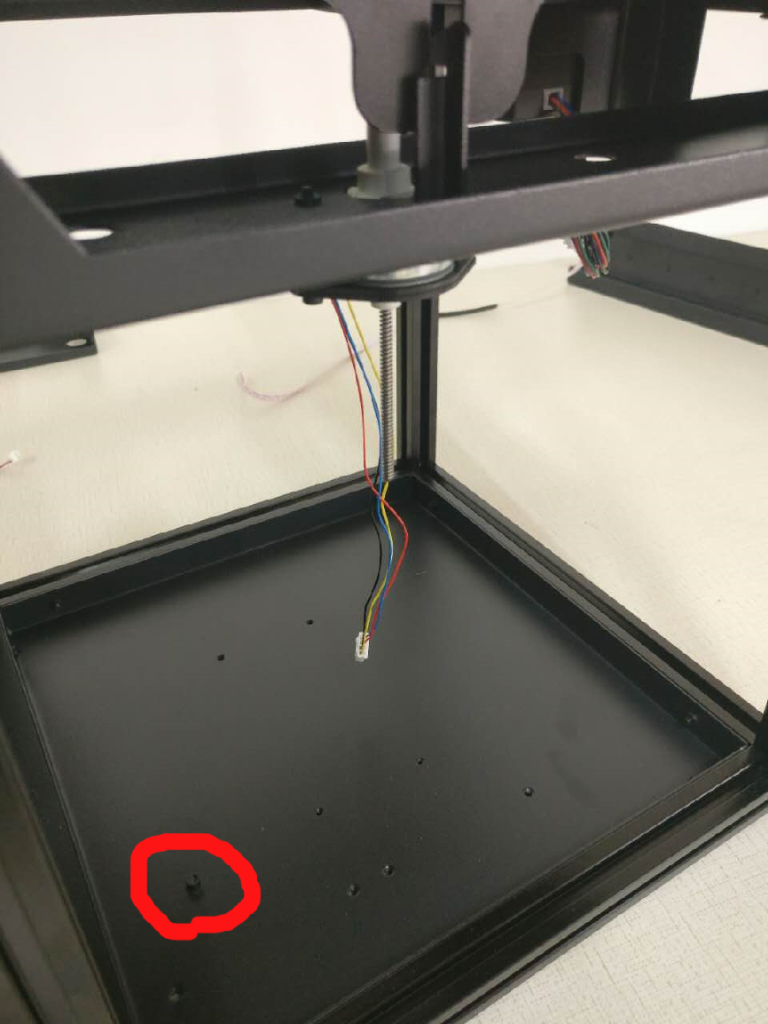
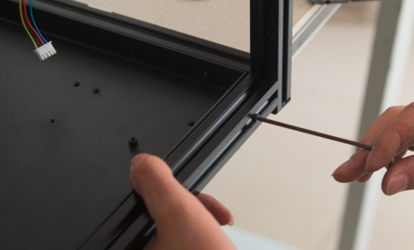
Find the Bottom piece, it has several screw holes on it and one elevated standoff screw hole. The standoff screw hole should be closest to the Front Frame. Use 8 CH M3-20 screws (2 on each side) to secure through the extrusions on all 4 sides.
Installer note:
install the screws for front and back first. If left and right 3 bars were not perfectly aligned, you may need to loosen their screws and align them to the bottom plate (by inserting the screws for the plate), then tighten the bar bolts down. None of the screws should require much force to start - if they do, it means something isn't aligned.

Slide 29
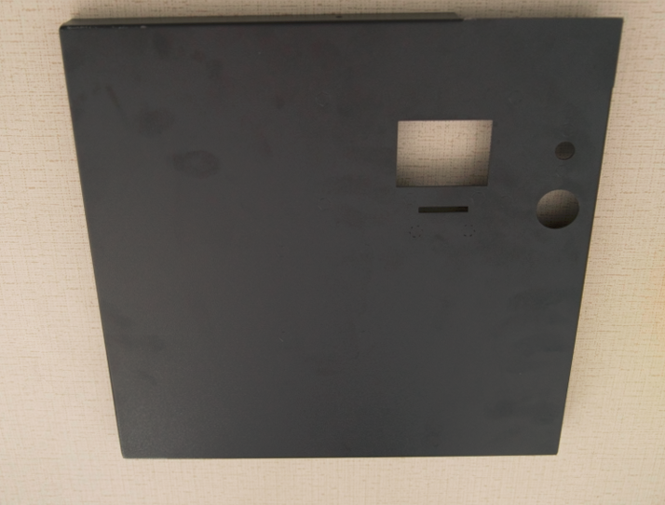
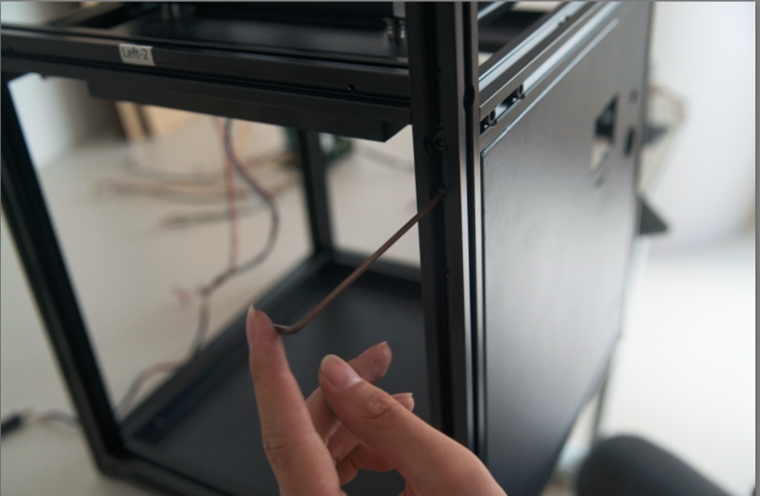
Find the Front Panel. Install it on the lower Front frame with 6 CH M3-20 screws. 2 each on Left/Right side. 1 each on Top/Bottom.
If you insert the top (center) screw first it will hold the panel snugly against the top, and then the left and right screws will be easier to align.

Slide 30
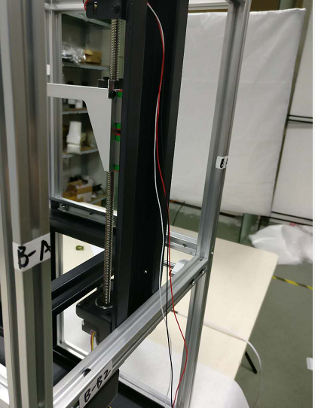
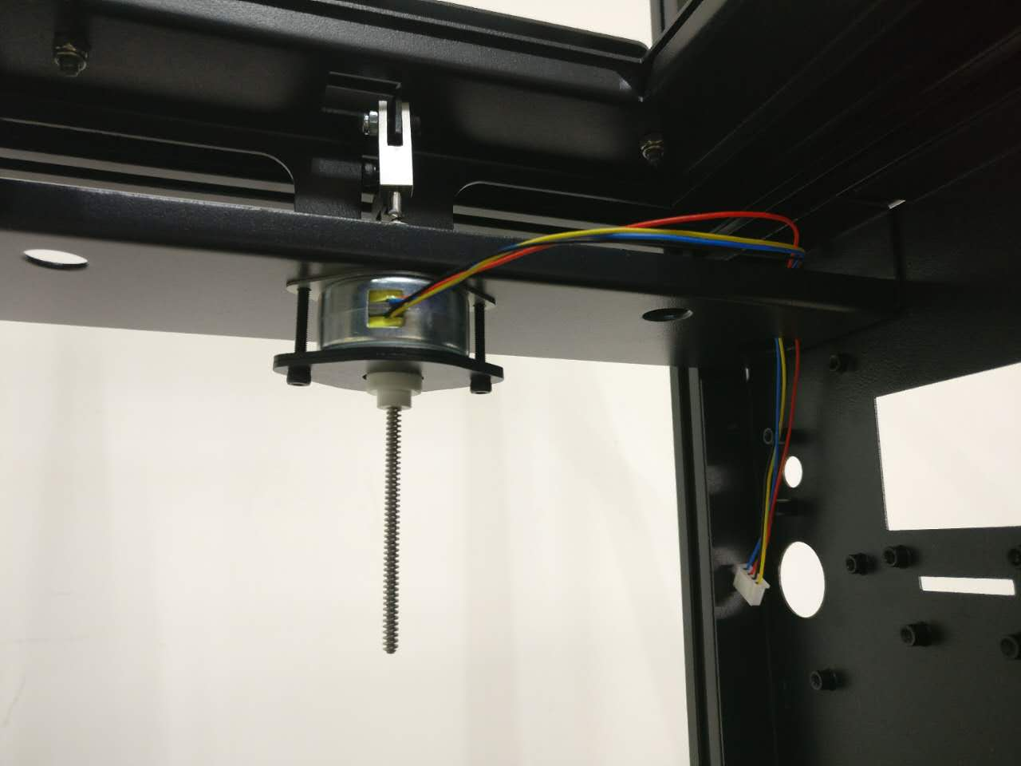
Now let’s arrange the Riser Motor cables and Endstop Sensor Cables as below:
Do NOT pass cables through the ½” holes on the Riser motor frame or it will prevent leveling the bed.

Slide 31
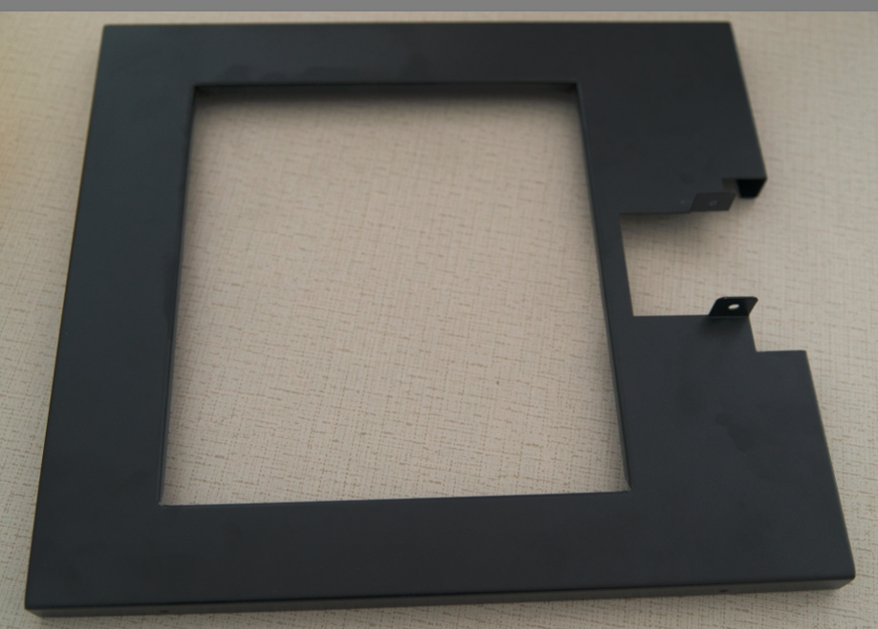
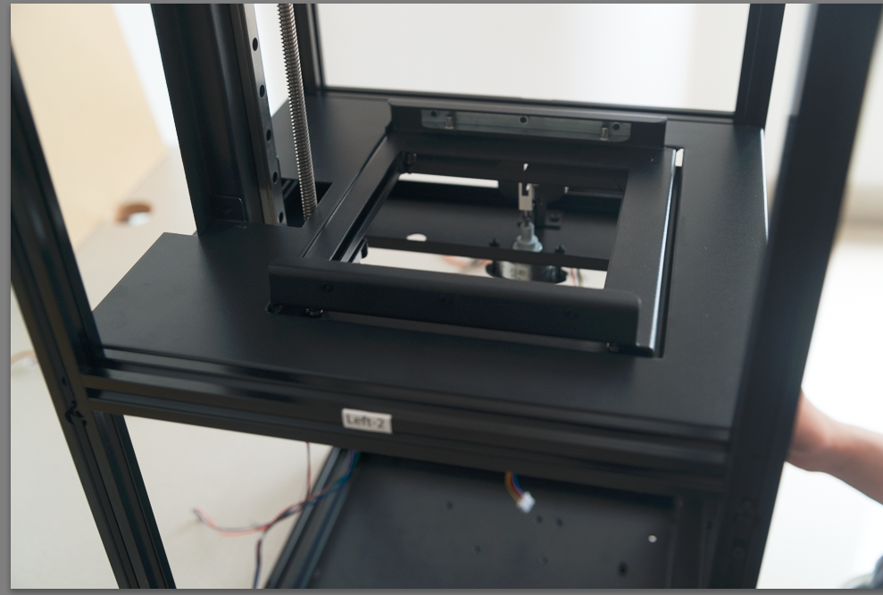
Find the Platform Cover. Use 2 CH M3-6 to secure to the Z-Axis Assembly. Use 4 CH M3-20 screws to secure to the Left and Right frames, 2 on each side.

Slide 32
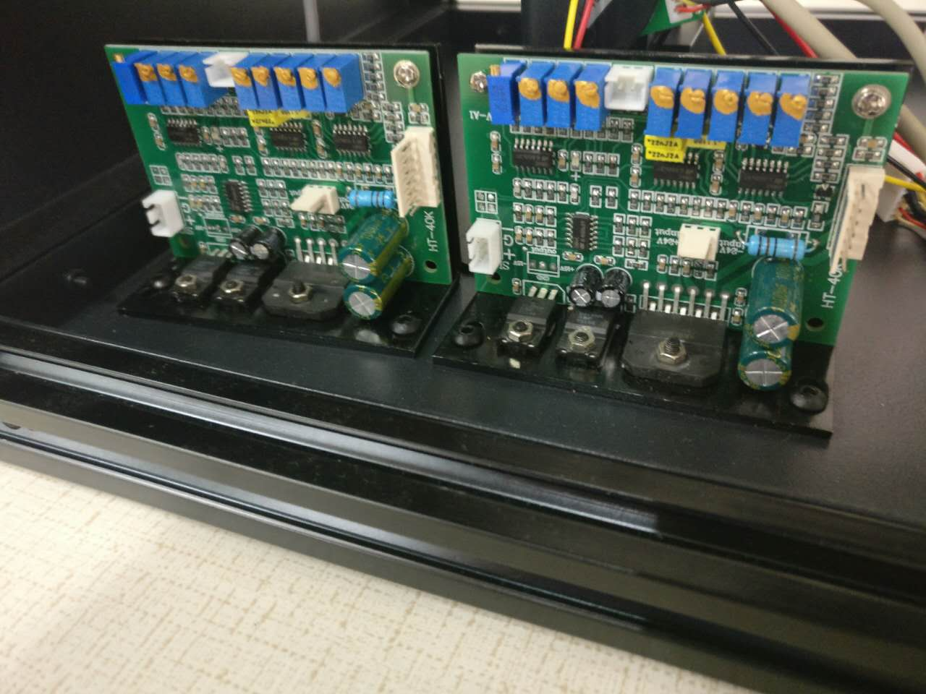
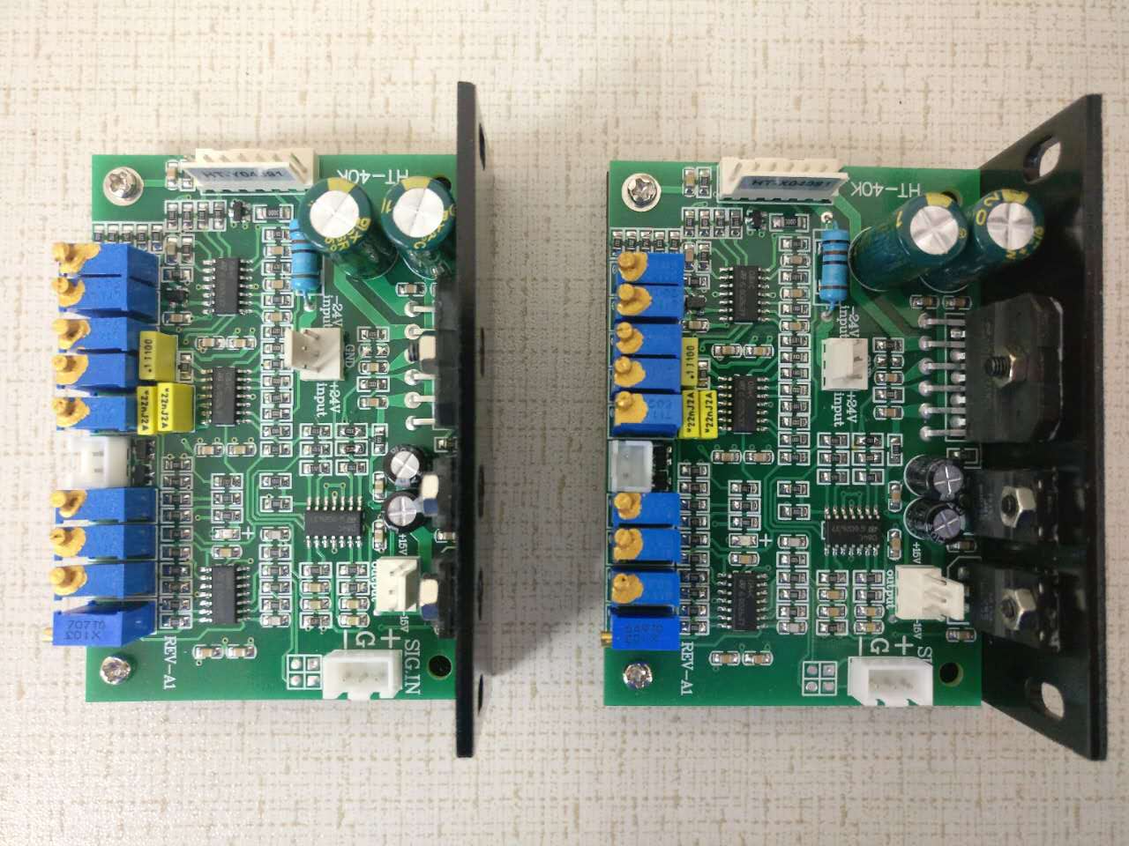
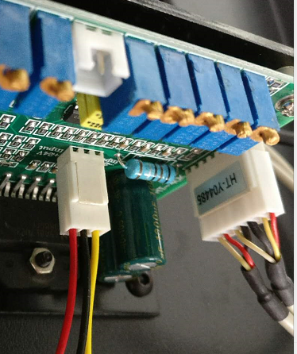
Now install Galvo Driver on the bottom panel. Secure with BH M4-6 Near the Right frame side Each Galvo Driver is designed for a specific Galvo. Look for the label on the Galvo Power port for indication. Example: HT-Yxxxx indicates the Y-Galvo.
***This is a common area where users make a mistake.
If the boards are the same on the front the assemblies have a X or Y label on the back.
X-Galvo
Y-Galvo
Right Frame

Slide 33
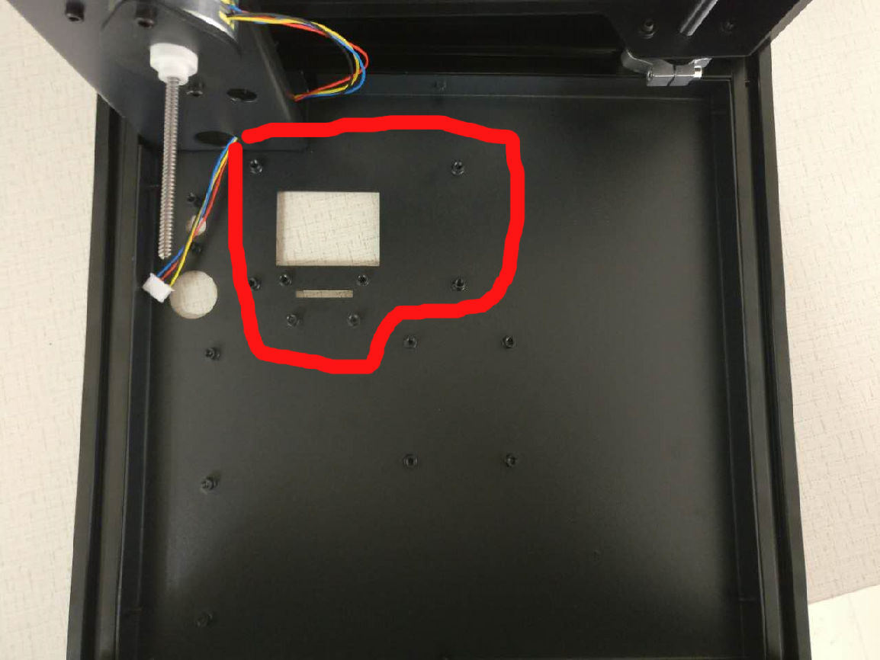
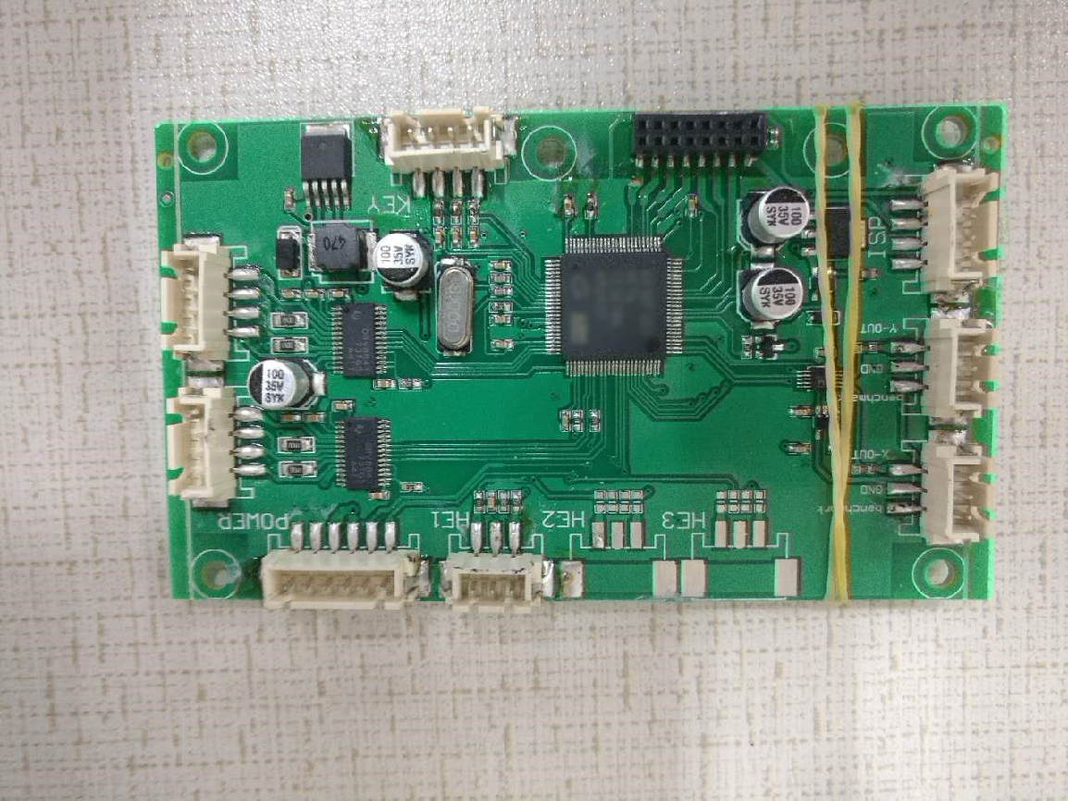
Lay the system down with Front Panel facing downward and Install the processing board with CH M3-5. Make sure you remove the LCD protective screen film before installing the board. Here is a detailed picture of the circuit board layout. The top of picture is the riser and z-axis motor: https://drive.google.com/open?id=0Bzke6lBHG_z5dm5RdDdJTHRRMDQ

Slide 34



Install the SD card reader on the included metal plate with 4 CH M3-5 screws. Plug the SD reader pins into the main board and secure the plate to the Front Panel with 2 CH M3-5 screws

Slide 35



Secure the Power Board (lower right picture) using 4 CH M3-5 screws. Here is a detailed picture of the circuit board layout. The top of picture is the Riser and Z-Axis motor: https://drive.google.com/open?id=0Bzke6lBHG_z5dm5RdDdJTHRRMDQ (Reshoot)
Top of Front Panel
Bottom of Front Panel

Slide 36


Secure the Control Knob through the large hole using CH M3-5 screws Here is a detailed picture of the circuit board layout. The top of picture is the Riser and Z-Axis motor: https://drive.google.com/open?id=0Bzke6lBHG_z5dm5RdDdJTHRRMDQ (Reshoot)
For circuit board installation, you can view video: https://www.youtube.com/watch?v=i9Qfwfzho98

Slide 37


Locate the Galvo/Laser Fixture box from the package
Carefully open the box and remove Galvo Laser Fixture DO NOT TOUCH GALVO MIRROR or LASER FRONT ELEMENT

Slide 38


First connect the Galvo Power Cables to the X/Y Galvos on the Fixture and then
install Laser / Galvo set on the bottom panel using 4 CH M3-6 screws, with the LASER opposite the Galvo Driver boards. DO NOT TOUCH GALVO MIRROR or LASER FRONT ELEMENT

Slide 39
Cabling: All cables have labels on them. Connect each cable by looking at below pics and matching the port name on each circuit board to the cable label. Diagram: needs update board picture reference: https://drive.google.com/open?id=0Bzke6lBHG_z5VWd2ZG1yQ182WE0 Driver picture reference: https://drive.google.com/open?id=0Bzke6lBHG_z5a1Ntek5tMUozNmM Laser/Galvo picture reference: https://drive.google.com/open?id=0Bzke6lBHG_z5V1RuM2dsNDFUYmM

Slide 40


Find and install Front Panel, Remove the protective paper and secure with 6 BH M3-16 screws. Install all screws before tightening.
It is probably easiest if you install the top screws first, then the cover will hang from them - and the rest of the holes will be aligned.

Slide 41




Install the Hinges and to the door using 4 FH M5x12 screws to secure to the Hinge backing plate.
Install Front Door to Front Panel with the Hinges and Hinge Shims using 4 FH M5x25 screws..

Slide 42



Install the Door Lock Set through the large hole in the door by pushing the Lock through the hole on the Door Panel from outside in. Screw the Ring in from the inside of the panel and screw the Lock Arm to the lock as seen in the right picture. The bent tab of the Lock Arm should face towards the door.

Slide 43


Install the Door handle to the door using 2 M5 x 3 Screws. (What size are these?)
This Side
Facing inside of printer
This Side
Facing inside of printer

Slide 44


Find the Control Knob. Install Control Knob by pressing it onto the Control Unit.
(I found that the knox needs a 3mm shim to account for the thickness of the acrylic or it won’t push in..)

Slide 45


Find Power Switch (See left picture) There is rubber O-ring and a metal nut. Remove both before installing.

Slide 46


Insert the Power Switch with cable through the Front panel hole. Put on therubber O-ring and then the metal nut Hand tighten the metal nut to secure Be careful not to damage the O-ring.
Connect the Power Switch Cable to the labeled port on the power board.

Slide 47



Remove the protective paper from the Back panel. Install Power Cable Extension by pulling the cable through the Back Panel’s hole. Use 6 BH M3-16 screws to securethe panel to the Back Frame.
it is probably easiest if you install the top screws first, then the cover will hang from them - and the rest of the holes will be aligned.

Slide 48


Install the Power Cable Extension to the coaxial power plug on the power board.

Slide 49


Before installing the remaining panels, arrange the cables so that they do not interfere with the laser beam using the included cable ties and cable restraints.
https://drive.google.com/open?id=10Hs4L5ChrQcMRv-hTj1OjxoXU1Nje65PGSYR9zzE0nU

Slide 50


Find the Acrylic protective lens as seen here. Install it to the top of the galvounit using 2 drops of silicone based gel (don’t use cyanoacrylate or tape. Make sure you remove both sides’ protective film before installing.

Slide 51



We recommend completing this last step ONLY AFTER LEVELING, and printing a successful TEST PRINT as the panels may hinder leveling. USE Protective Glasses when running tests with panels off! Install Left, Right and the Top panels. Use 6 BH M3-16 screws for Right and Left and 4 for the Top Panel. Make sure the edge Bevel on each panel is facing outward.

